Slide 1
Here Be Dragons JavaScript Debugging
Rami Sayar - @ramisayar
Technical Evangelist
Microsoft Canada

Slide 2

Image from http://www.desertislandsupplyco.com/mapper-delight-here-be-dragons
Notes:
"Here be dragons" means dangerous or unexplored territories, in imitation of a supposed medieval practice of putting dragons, sea serpents and other mythological creatures in uncharted areas of maps.^{[1]}

Slide 3
Agenda
Types of Errors in JavaScript
Frequent Locations of Errors in JavaScript
Debugging and Introspection Tools
Remote Debugging Node Processes
Remote Debugging Front-End JavaScript

Slide 4
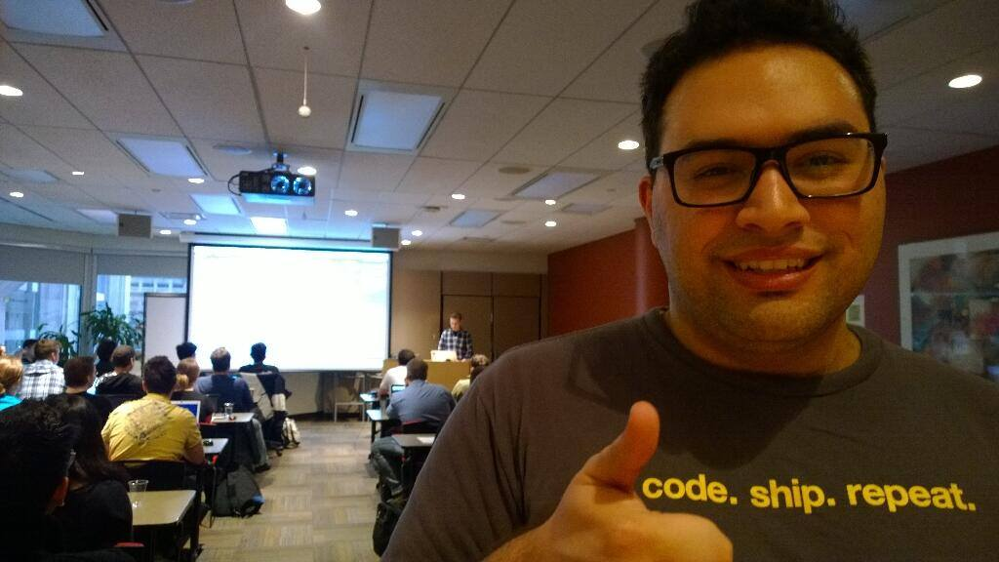
@ramisayar

Slide 5
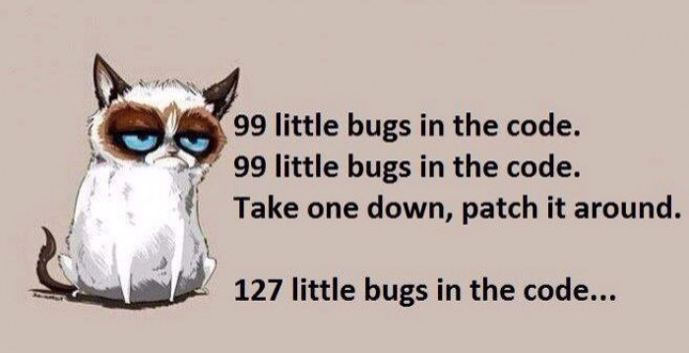
Image from developermeme.com

Slide 6
Types of Errors in JavaScript
Loading Errors
E.g. Incorrect syntax, minification errors, network-related errors, missing files, etc.
Runtime Errors
E.g. Syntax errors, misspelled variables, illegal assignment, variables/classes don’t exist, etc.
Logic Errors
E.g. BUGS! But also errors due to format and parameters (JSON vs XML), etc…

Slide 7
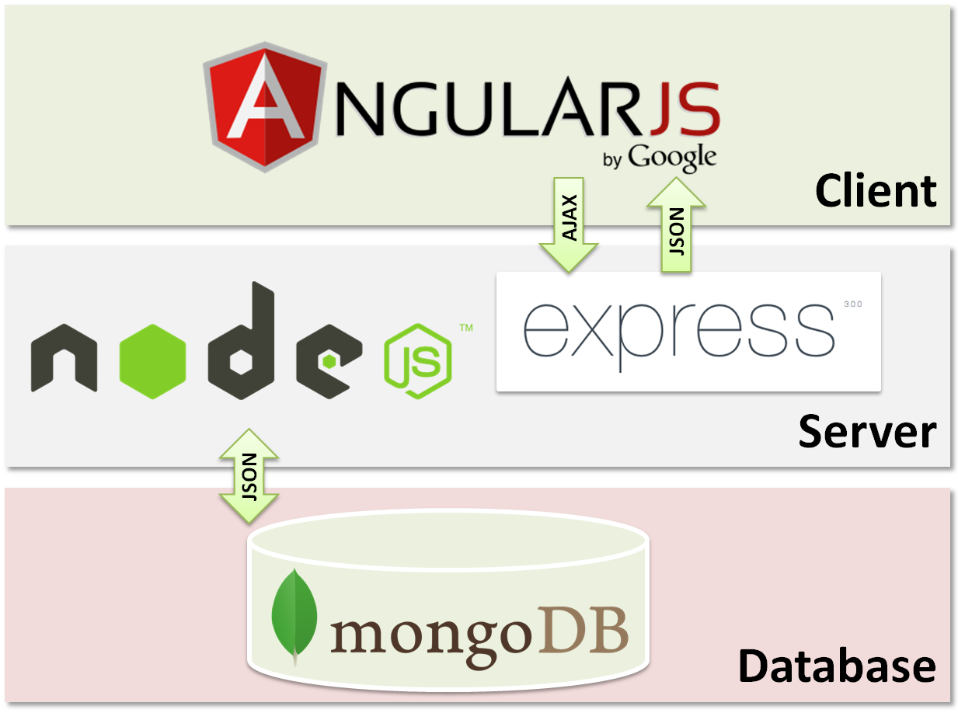
Locations of Errors in JavaScript
errors here
errors here
errors here

Slide 8
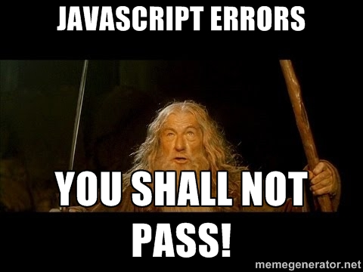

Slide 9

But what really happens…

Slide 10
Debugging & Introspection Tools
DEMOS!

Slide 11
Typical Logic Errors in JavaScript
Using this wrong an scoping errors
Accidentally creating memory leaks
Dangling references to unused objects
Circular references
Incorrect coercion, comparisons and equality
Incorrect references to instance objects & prototypical inheritance errors
So much more…

Slide 12
Debugging & Introspection Tools
Allow you to control execution and walk through line-by-line
Debug with breakpoints to conditionally stop execution
Examine the call stack
Pause on exceptions
Stack trace exceptions

Slide 13
Demo: Introspection Tools
https://gist.github.com/sayar/3ffa68c1765b8e6d78e0

Slide 14
Debugging Node Apps – node-inspector
Node Inspector supports almost all of the debugging features of the Blink DevTools, including:
Set breakpoints (and specify trigger conditions)
Step over, step in, step out, resume (continue)
Inspect scopes, variables, object properties
Edit variables and object properties
Break on exceptions
CPU and HEAP profiling
Network client requests inspection
Console output inspection

Slide 15
Debugging Node Apps – node-inspector
Other cool stuff:
Node Inspector uses WebSockets, so no polling for breaks.
Remote debugging
Live edit of running code, optionally persisting changes back to the file-system.
Set breakpoints in files that are not loaded into V8 yet - useful for debugging module loading/initialization.
Embeddable in other applications

Slide 16
Demo: Node-Inspector
npm install -g node-inspector
node-debug app.js

Slide 17
IDE Demo: Code
It’s free and runs on Linux/OSX/Windows.
There’s also WebStorm and Eclipse.

Slide 18
Not All Debugging Happens During Development…

Slide 19
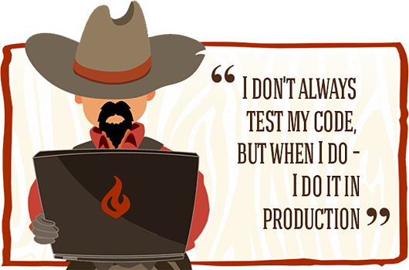
Occasionally…
Image from https://www.siteground.com/blog/siteground-staging/

Slide 20
You Can Debug Production Node Applications!
Debugging node applications is easy if you know you want to debug… It gets harder when you want to connect to already-running production applications…

Slide 21
Enabling Debugging on a Node Process
On OSX/Linux…
$ pgrep -l node
2345 node your/node/server.js
$ kill -s USR1 2345
On Windows…
> tasklist /FI “IMAGENAME eq node.exe”
> node -e “process._debugProcess(3084)”

Slide 22
Connecting to a Remote Node Process
With built-in node debugger:
$ node debug localhost:5858
With node-inspector:
$ node-inspector
With Visual Studio Code
Use Attach launch setting, debug… ☺

Slide 23
Demo: Debugging Remote Node Process

Slide 24
“your website doesn’t work on my pc”
Who hasn’t heard that one or a variant before?

Slide 25
Debugging JavaScript in Remote Browsers
Wait… what! You can do that?

Slide 26
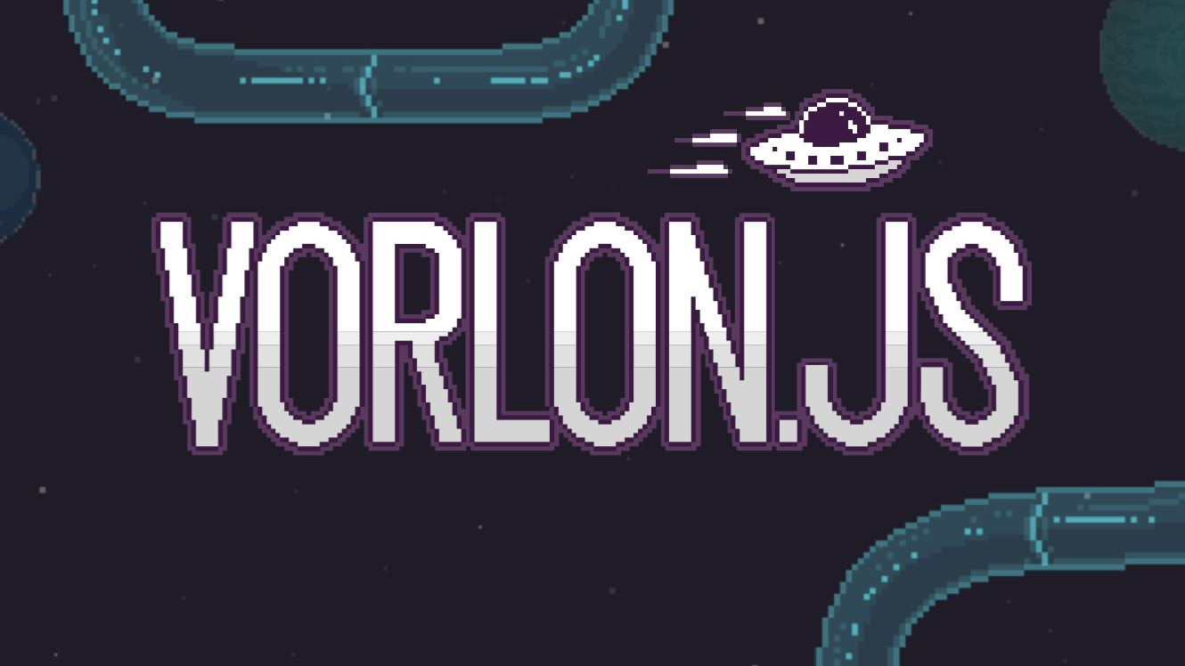

Slide 27
Vorlon.JS
An open source, extensible, platform-agnostic tool for remotely debugging and testing your JavaScript.
Plugins:
Console: View logs and errors for your application.
Modernizr: View a list of supported and unsupported features.
DOM Explorer: Inspect the DOM tree and its corresponding styles.
Object Explorer: Display the living JavaScript variables tree.
XHR Panel: View XHR calls information sent by your devices.
ngInspector: Inspect your Angular.js scopes
Network Monitor: View network activities (XHR & resources loading).
Resources Explorer: Inspect local resources such as localStorage or cookies.

Slide 28
Getting Started with Vorlon.JS
$ npm install -g vorlon
$ vorlon
Add to your code.
<script src="http://localhost:1337/vorlon.js"></script>
Open http://localhost:1337

Slide 29
Using Vorlon.JS to Remote Debug
Deploy Vorlon.JS to a public server/PaaS/wtv.
As simple as a git push
Add this to your public beta website:
<script src="http://mywebsite.com/vorlon.js"></script>

Slide 30
Demo: Public Vorlon.JS - bit.ly/jsopendemo
Note: Don’t do this in production with SSL and authentication setup. Better yet, only do this in staging/beta.

Slide 31
Other Tools: Vantage
Vantage = CLI + SSH + REPL for your live node app

Slide 32
Demo: Vantage
$ npm install -g vantage
$ vantage tour

Slide 33
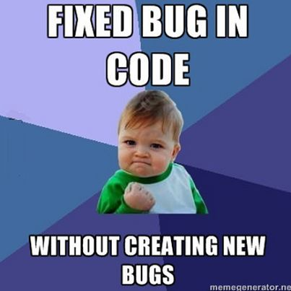

Slide 34
What did we learn?
Types of Errors & Locations in JavaScript
Debugging and Introspection Tools
node-inspector
VS Code
Remote Debugging Node Processes
node-inspector, VS Code
Vantage
Remote Debugging Front-End JavaScript
Vorlon.JS

Slide 35

Image from Mendhak, licensed under CC Attribution-ShareAlike 2.0 Generic

Slide 36
Thank You! Questions?
tw: @ramisayar | gh: @sayar
slideshare.net/ramisayar

Slide 37
Resources, References, Links
http://www.toptal.com/javascript/10-most-common-javascript-mistakes
https://developers.google.com/web/tools/javascript/breakpoints/
http://www.w3schools.com/js/js_debugging.asp
http://www.webreference.com/programming/javascript/rg31/index.html
http://eloquentjavascript.net/08_error.html
http://www.pluralsight.com/courses/fixing-common-javascript-bugs
https://trackjs.com/
http://www.standardista.com/javascript/15-common-javascript-gotchas/

